Slide 1
The Case for Git (Flow)

Slide 2
Goals
Learn more about git
Do it right the first time
Save time later
Eliminate pain in dev process
Never again sit in a 3 hour merge meeting

Slide 3
3 Hour Merge?!
12-15 total developer time
Every two weeks?
Not even a large code change
Secretary doing the job of the tools
Painful merging into trunk
Is this going to work?
Simple refactors causing extra work
Using statements / whitespace / renaming / moving / cleaning up empty folders

Slide 4
DON’T PANIC!
GIT WILL FIX IT!
... no it won’t
... but we can

Slide 5
Secretary
On the plus side, I think git will mostly fix this…
A problem with the tools
TortoiseSVN sucks at finding new files
“git add -A .” will, without a doubt, find all files.
But don’t forget the “-A”

Slide 6
Painful Merging
Everyone says it is better in git
But… if we keep doing it the “svn way”, it won’t be
Problems?
Committing directly to trunk
Not committing often

Slide 7
Solution #1: Never commit to trunk
Ever.
NEVER, ever.
Why?
Fast-Forward Merges
No untested code in master
Notes:
Make sure to explain fast forward merges.

Slide 8
Solution #2: Commit Early, Commit Often
Topic branches
Branching is free and easy
Commit often
More history
Why?
Easier merges into develop
“git cherry-pick” if needed
“git bisect” if things go wrong
Less to lose if everything goes wrong
Notes:
Make sure to explain why branching is free – because branches are just references to commits. They are literally a few bytes.

Slide 9
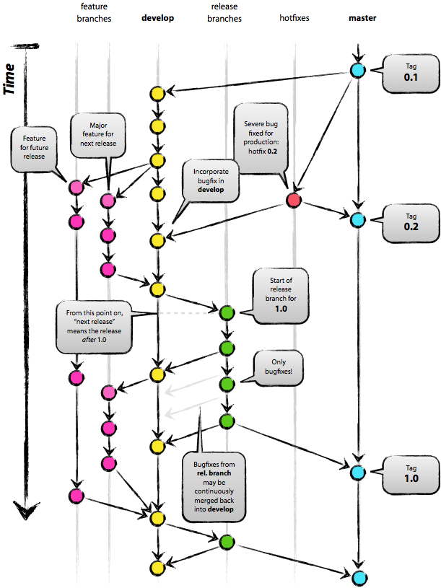
Introducing: GitFlow
Notes:
Easier than it looks. I promise.

Slide 10
Two main branches
Master
Always current state of production
Never ever commit directly to this branch
Develop
Always represents “version.Next”
Not a crime to commit to it
But should avoid it

Slide 11
Feature Branches
Named “whatever-youre-working-on”
Local repo usually
Branch from Develop
Merge into Develop

Slide 12
Release Branches
Named “release/v1.2.3”
Branched from develop
Represent a new release candidate
Could then be tested by QA
Fixes committed to this branch
Avoid committing large features
When ready to go, we tag it and merge it:
Into master: deploy to prod now
Into develop: So any bug fixes go back

Slide 13
Hotfix Branches
Oh noes! A wild bug has appeared!
Named “hotfix/v1.2.3.a”
Branched from master
Fixes made, QA tests
Tag it, merge it:
Back into master: deploy to prod
Into Develop

Slide 14
Summary
CONS:
More complicated
Stricter Rules
PROS:
Fits neatly into existing workflow
Proven
Git extensions
Future possibility: Parallel development/testing
PEANUT BUTTER DEMO TIME!

Slide 15
Opinion Time!
Why I think TortoiseGit sucks
It pretends that git is svn
It hides important details
What branch are you working on?
What is it doing behind the scenes?
It is limited
It is worth learning git cli
One of the best windows CLI tools
Aliases

Slide 16
Okay, why did I install tortoisegit?
Easier staging of commits
Visual commit graph is nice
Mergetool
Show how to set this up
Or use bc3

Slide 17
References
Git Community Book
http://book.git-scm.com/
Pro Git Book
http://progit.org/book/
Git Flow
http://nvie.com/posts/a-successful-git-branching-model/
GitHub Flow
http://scottchacon.com/2011/08/31/github-flow.html

